Slide 1
What Is the Key to Applying the Bible to My Life?
Rev. Dr. Otis McMillan
Bible Study Series

Slide 2
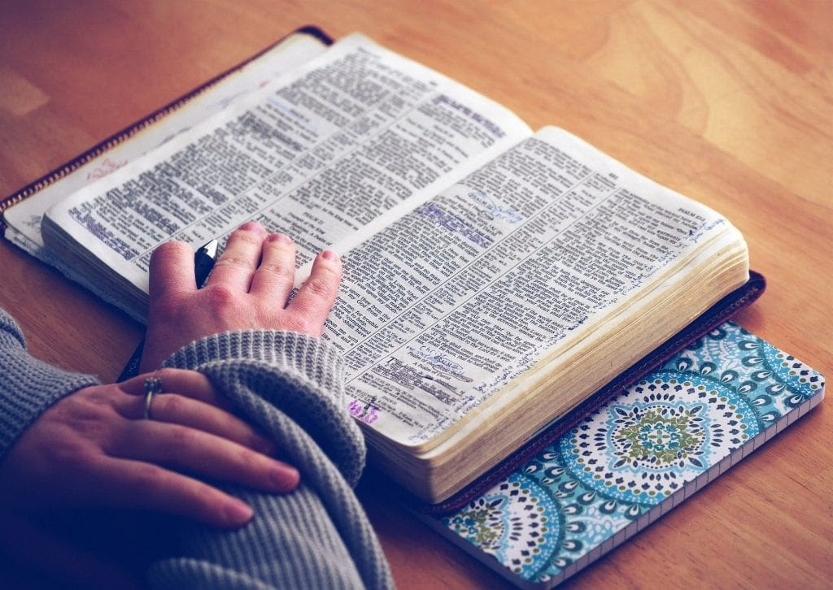
Learning what this means and how to do it by reading and meditating on the Bible daily.
Mt 22:37 Jesus said unto him, Thou shalt love the Lord thy God with all thy heart, and with all thy soul, and with all thy mind

Slide 3
What Is the Bible? God’s Revelation of Himself to Mankind
It is made up of 66 books with 40 different authors.
These authors were fishermen, government officials, farmers, shepherds, doctors, priests, and kings
written over a period of 1,500 years.

Slide 4
“All Scripture is inspired by God and is useful to teach us what is true and to make us realize what is wrong in our lives. It corrects us when we are wrong and teaches us to do what is right.” (2 Timothy 3:16, NLT).
Every word of the Bible is relevant and still applies to our lives today.

Slide 5
Without our hearts grounded in the Bible, our passions, desires, thoughts, perceptions, and affections would not be aligned with God. We were created with our will, our hearts, our desires, and our thoughts.
Because God created us, He intimately knows our hearts. And He reminds us in Proverbs 4:23, “From the heart, flow the springs of life.”

Slide 6
As we love God, His Word begins to change our spirit, which creates a ripple effect in every area of our lives.
To apply the Bible
we must know the Bible. This means we listen to it, we read it, meditating on Scripture day and night.
But don’t just listen to God’s word. You must do what it says. Otherwise, you are only fooling yourselves. For if you listen to the word and don’t obey, it is like glancing at your face in a mirror. You see yourself, walk away, and forget what you look like.
6

Slide 7
How Do I Apply the Bible to Life?
Learn God’s Ways
Our goal in reading the Bible is to get to know God’s ways and to understand his purpose for the world and for ourselves.
2. Live God’s Ways
Next, we begin to hide God’s word in our hearts (Psalm 119:11). Knowing God’s word enables us to filter our lives through the Bible. It opens our eyes to what godly living looks like. The Holy Spirit will help us apply the Bible to our lives, as He whispers His love and directions for us.
7

Slide 8
One of the ways I learned to apply the Bible to my life was through the S.O.A.P. method. It helps interact with God’s word so you can discover life principles and truths for your daily walk with the Lord. The Holy Spirit Will Help You Apply the Bible to Your Life
S
Scripture Intake!
You can write out Scriptures in a notebook.
O
Observation!
During this step, you basically ask yourself: What do I see, and what does it mean?
A
Application! Make God’s word personal in your life. What is God saying to me today? Do I need to make changes? Do I need to take action?
P
Prayer! Asking God to work in your life concerning the truths you’ve just discovered.
8

Slide 9
The Value of God’s Word Scripture Text: Joshua 1:8; Isaiah 55:8-9, 2 Tim 3: 16-17
Going Deeper
This Photo by Unknown Author is licensed under CC BY-SA-NC

Slide 10
Two Key Scriptures for Consideration
(Josh 1:8) “This Book of the Law shall not depart from your mouth, but you shall meditate in it day and night, that you may observe to do according to all that is written in it. For then you will make your way prosperous, and then you will have good success.”
Jer. 8:9 “The wise men are ashamed, they are dismayed and taken. Behold, they have rejected the word of the LORD; So what wisdom do they have?”
10

Slide 11
There is a drifting from the word or perhaps even a forsaking of the word of the Lord in our country. We will not be a part of that.
A study by the Barna Institute found that the number of people skeptical or agnostic toward the Bible nearly doubled from 2011 to 2014. Those believing that the Bible is “just another book of teachings written by men that contain stories and advice” doubled during that three-year period.
11

Slide 12
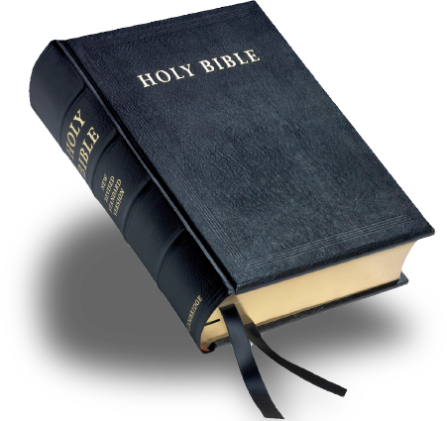
Four things we must do in our relationship with the word of God
I. Respect the authority of the revelation in the word.
This is about our attitude toward the Bible. Is Bible only a book filled with interesting stories and advice from well-meaning men? No, it is much, much more than that. It is a revelation from God.
II. Meditate on the revelation God has given in His word.
Engage the word with your mind! Read it; study it; ponder it’s meaning for your life. When God told Joshua to meditate on the word day and night, He was essentially saying, Let the word fill your thought life.
III. Live by the revelation God has given in His word.
In the book of Deuteronomy, Moses reflected on His journey with the Children of Israel. In Deut. 8:2-4 he specifically pointed out an essential lesson God had taught them.
IV. Share the revelation God has given in His word.
I want to encourage you to not be ashamed of the gospel of Jesus Christ. The culture has become more and more aggressive in opposing it. But it remains their only hope of salvation.

Slide 13
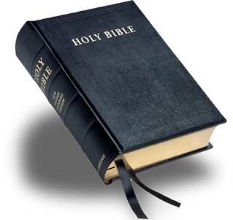
Our attitude toward Scripture must be one of respect and high regard. So much so that we let Scripture pass judgement on us rather than us picking through it and passing judgement on it.
13

Slide 14
Peter wrote in his second epistle, “knowing this first,” [as a priority get this down first of all] “that no prophecy of Scripture is of any private interpretation, 21 for prophecy never came by the will of man, but holy men of God spoke as they were moved by the Holy Spirit” (2:20-21).
14

Slide 15
In Isa 55:8-9 God says, "For My thoughts are not your thoughts, Nor are your ways My ways," says the LORD. 9 "For as the heavens are higher than the earth, So are My ways higher than your ways, And My thoughts than your thoughts.”
15

Slide 16
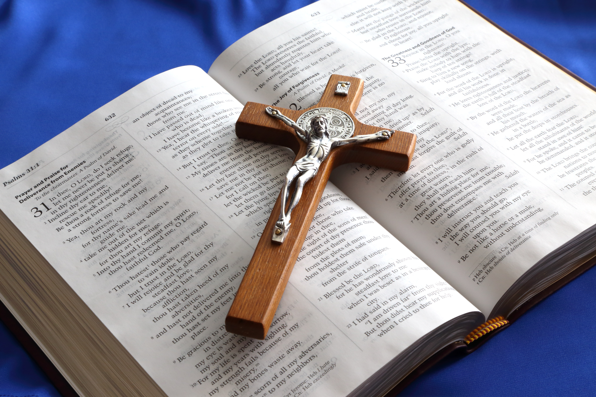
Paul wrote in 2 Tim. 3:16, “All Scripture is given by inspiration of God, and is profitable for doctrine, for reproof, for correction, for instruction in righteousness, 17 that the man of God may be complete, thoroughly equipped for every good work.”
16

Slide 17
Engage the word with your mind! Read it; study it; ponder it’s meaning for your life. When God told Joshua to meditate on the word day and night, He was essentially saying, Let the word fill your thought life. .
II. Meditate on the revelation God has given in His word.
17

Slide 18
It’s not enough to just abstractly believe it is inspired of God and authoritative. We must engage the word in our thought life on a regular basis. We must read the word so that we know what it says. We must study its contents so we interpret it rightly. We must ponder it and apply it to our daily decisions.
Website

Slide 19
The Scripture has a sanctifying influence that we need daily. “How can a young man cleanse his way? By taking heed according to Your word. 10 With my whole heart I have sought You; Oh, let me not wander from Your commandments! 11 Your word I have hidden in my heart, That I might not sin against You” (Ps. 119:9-11).
This Photo by Unknown Author is licensed under CC BY-SA-NC

Slide 20
III. Live by the revelation God has given in His word. In the book of Deuteronomy, Moses reflected on His journey with the Children of Israel. In Deut. 8:2-4 he specifically pointed out an essential lesson God had taught them. “And you shall remember that the LORD your God led you all the way these forty years in the wilderness, to humble you and test you, to know what was in your heart, whether you would keep His commandments or not. 3 So He humbled you, allowed you to hunger, and fed you with manna which you did not know nor did your fathers know, that He might make you know that man shall not live by bread alone; but man lives by every word that proceeds from the mouth of the LORD.”

Slide 21
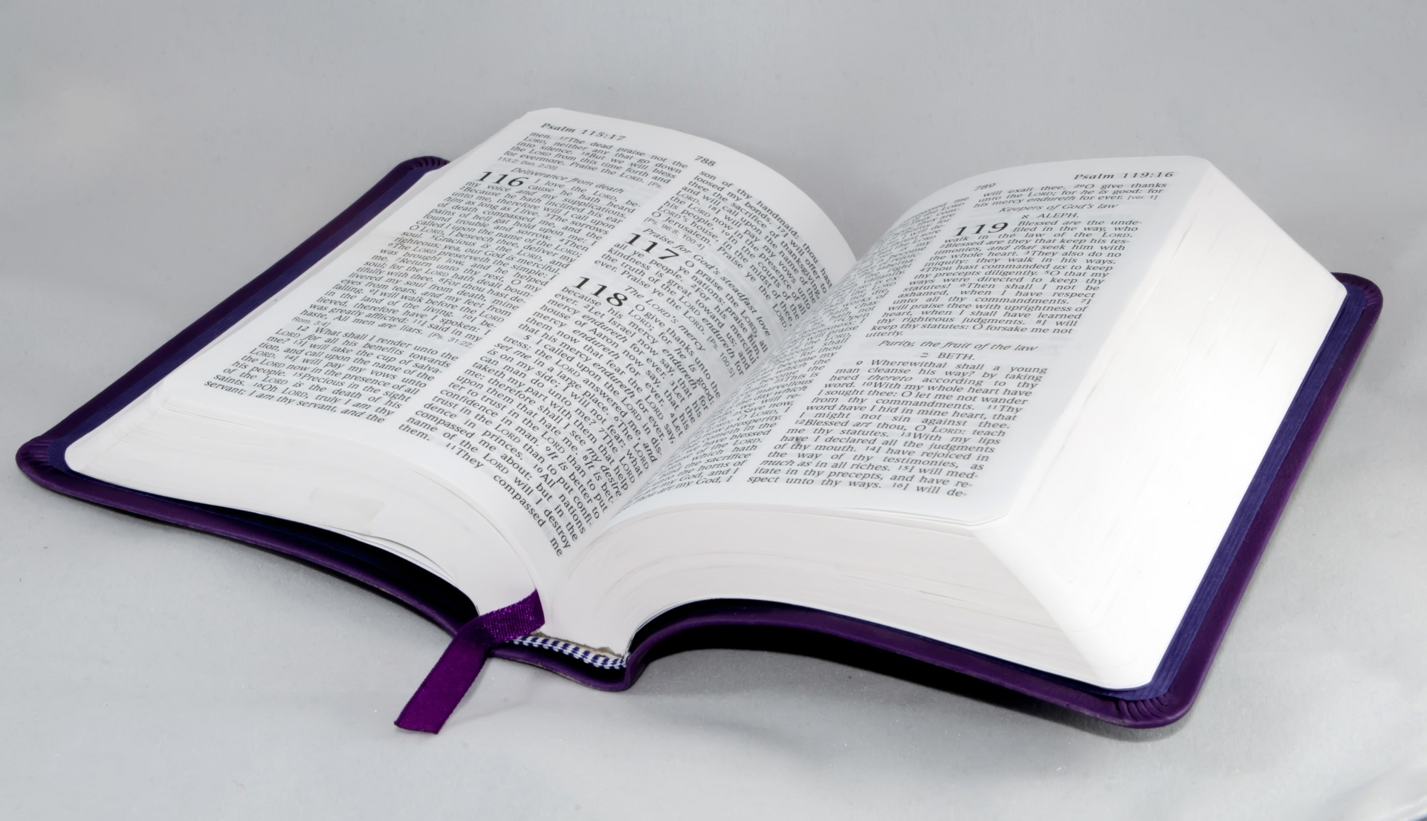
Psalmist said to the Lord, “Your commands make me wiser than my enemies, for they are ever with me. I have more insight than all my teachers, for I meditate on your statutes. I have more understanding than the elders, for I obey your precepts” (Ps 119:98-100 NIV).

Slide 22
IV. Share the revelation God has given in His word.

Slide 23
Share the revelation with others and let the Holy Spirit do His work on their hearts. Paul wrote in 2 Tim 4:2-5, “Preach the word! Be ready in season and out of season. Convince, rebuke, exhort, with all longsuffering and teaching. 3 For the time will come when they will not endure sound doctrine, but according to their own desires, because they have itching ears, they will heap up for themselves teachers; 4 and they will turn their ears away from the truth, and be turned aside to fables. 5 But you be watchful in all things, endure afflictions, do the work of an evangelist, fulfill your ministry.”

