Slide 1
Office 365 Integration
Three Step Process

Slide 2
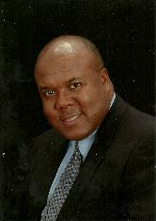
The African Methodist Episcopal Zion Church
Office of the General Secretary-Auditor
The Reverend J. Elvin Sadler, D.Min.,
General Secretary-Auditor
The Reverend Tajuan J. Kyles,
Executive Assistant to the General Secretary-Auditor

Slide 3
Imminent Launch of Forms Management System
We are quickly approaching the Connectional launch of our forms management system. This system will enable you to more effectively enter your pertinent information through an interactive database system. In order to prepare you for the launch and to assist you with becoming more acquainted with the system, we are recommending a three-step process or Office 365 integration, forms introduction and website management.

Slide 4
Step One:
Office 365 Integration
We are excited to announce that each church in our denomination is being offered Enterprise E1 Office 365. This is an online version, which provides you all of the features of Office 365, including Microsoft Word, PowerPoint, Excel, OneNote, Outlook, SharePoint, OneDrive (1TB), Skype for Business and eight other applications. This is a $120.00 value, which is provided to you for free and included in your annual license fee!
Office 365 will give you the tools necessary to effectively manage our interactive database management system using Excel and OneDrive. The good news is that not, only can you use these for the system, but you can download the Office 365 app on your tablet or smart device and use ALL of the features for more effective ministry administration and execution.
Office 365 is available to you NOW and is ready for your activation!

Slide 5
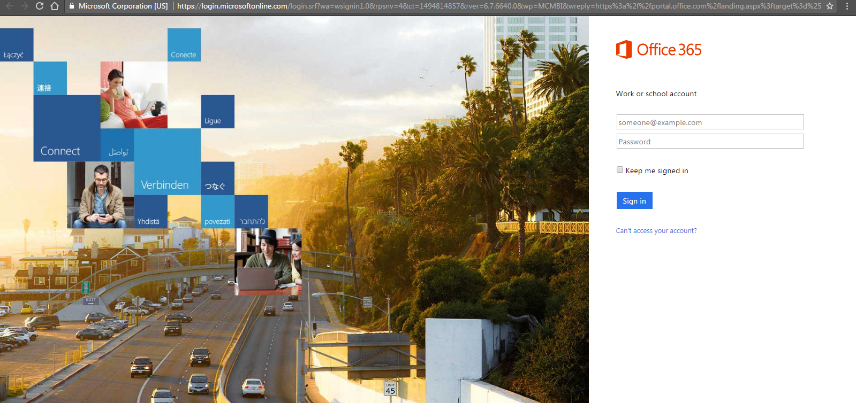
Follow these steps to get activated
Get your user id from your Presiding Elder.
Go to your web portal (Google Chrome, Firefox, Edge, etc.) and type in portal.office.com. This will open the window to allow you to access your office portal.

Slide 6
Follow these steps to get activated
Type in your userid@ameziongsa.com. For example:abcccdsaed@ameziongsa.com.
Type in your password. Everyone has the same initial password, which is: Abc123abc1.
  You must enter it exactly as it is listed.
  Once you enter it, you will be redirected to a window that ask you to create your unique password. Make sure you WRITE DOWN AND KEEP YOUR PASSWORD! Press enter.
You will be directed to your applications page and you will see all of the features at your disposal.

Slide 7
Download Apps
While all of the features of Office 365 are available to you online, there are two features that you can download to your device. They are: Skype for Business (unlimited use of Skype available to you as a part of your annual licensing fee) and OneDrive (1 TB [terabyte] of cloud storage); make sure you download both for future use,

Slide 8
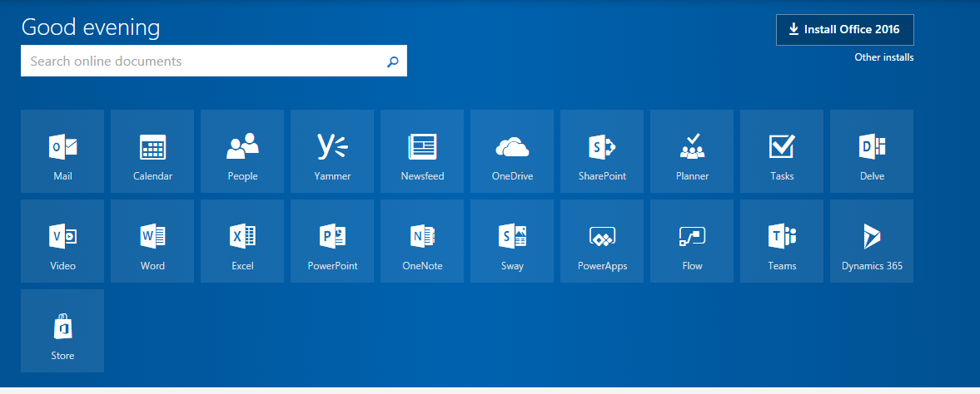
Download Apps
Download the OneDrive app. Click Install Office 2016.

Slide 9
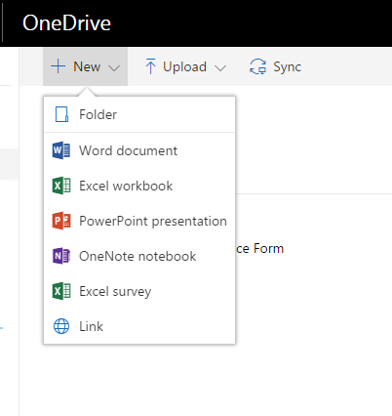
Download Apps
After you have downloaded it, open it up and create a folder entitled “Quarterly Conference Reporting”;
Click on OneDrive. Click on New and then Click Folder.

Slide 10
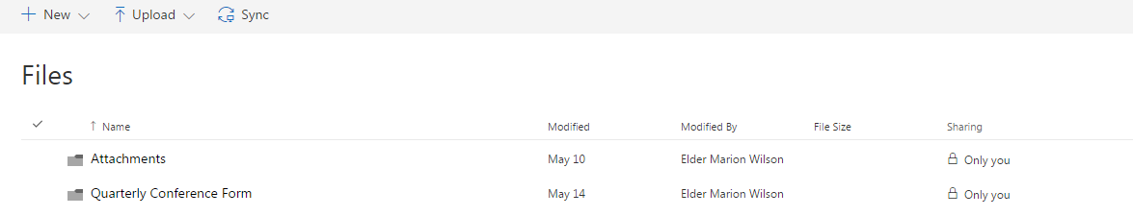
Download Apps
Once you have activated the app and created the folder, you can close it;

Slide 11
YOU’RE FINISHED WITH STEP ONE!!!
Also, make sure you download the apps for Office 365 from the Google or Apple Store for your mobile devices. It will allow you to use the features on your tablet or smart device.
Begin to become familiar with Office 365.
Should you have questions about Office 365, you can go to the support feature on your portal page and they will help you.
You're all set with Phase One!

Slide 12
Step Two: www.AMEZionGSA.com
Integration
Now that you’ve downloaded 365, the next step is to login to the AMEZionGSA website.
This is the portal we will use to access our Quarterly Conference Forms and other forms in the future.

Slide 13
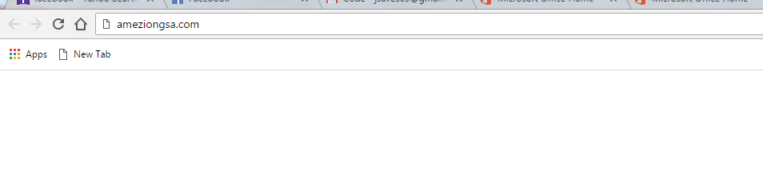
Step Two: www.AMEZionGSA.com
Integration
Please follow these steps to access the forms.
Go to your web portal (Google Chrome, Firefox, Edge, etc.) and type in www.ameziongsa.com,

Slide 14

Step Two:
www.AMEZionGSA.com
Integration
Once you type in the website you should arrive at the screen below:
.

Slide 15
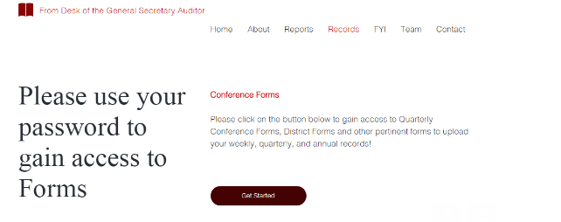
Step Two: www.AMEZionGSA.com
Integration
Click Records and it will take you to this screen.
Conference Forms should appear and then you click-Get Started.

Slide 16
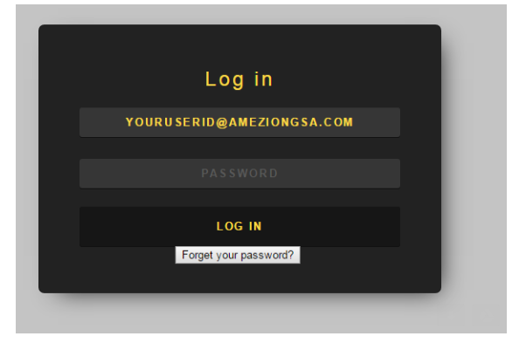
Step Two: www.AMEZionGSA.com
Integration
You should now see this screen. You will then type in your userid@ameziongsa.com (i.e., ABCccdsaed@ameziongsa.com) and the initial password you will use is p@ssw0rd.

Slide 17
Step Two: www.AMEZionGSA.com
Integration
You will then see the screen below. Once you see this screen, click “Import Excel File”.

Slide 18
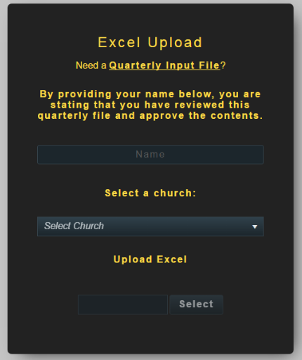
Step Two: www.AMEZionGSA.com
Integration
Once you click on
“Import Excel File,”
you will see this screen.
Click “Quarterly Input File”.

Slide 19
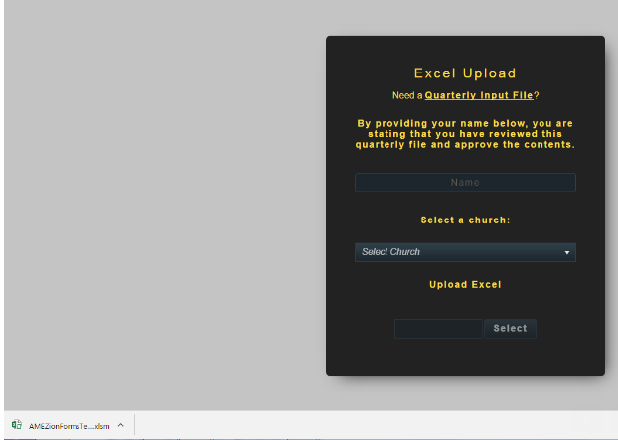
Step Two: www.AMEZionGSA.com
Integration
You will now see at the bottom left hand corner of your screen, a download of the Quarterly Conference forms in an Excel Spreadsheet.
Click the document.

Slide 20
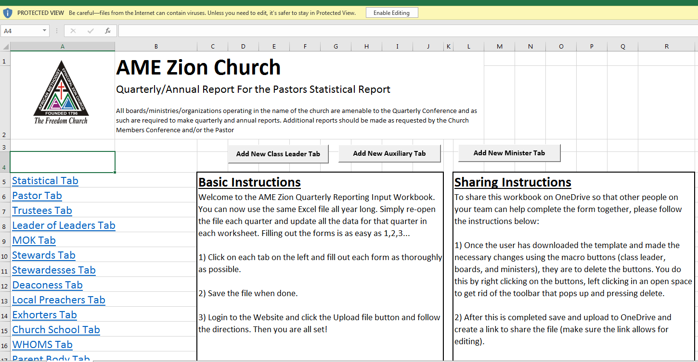
Step Two: www.AMEZionGSA.com
Integration
  The Excel Online window will open;

Slide 21
Step Two: www.AMEZionGSA.com
Integration
Click Enable Editing

Slide 22
Step Two: www.AMEZionGSA.com
Integration
Select the report or tab that you would like to work on.

Slide 23
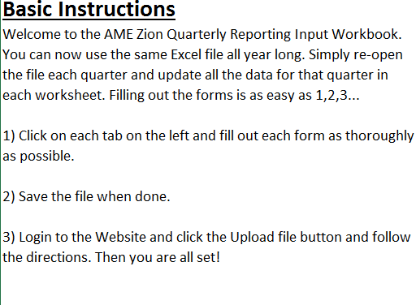
Step Two: www.AMEZionGSA.com
Integration

Slide 24
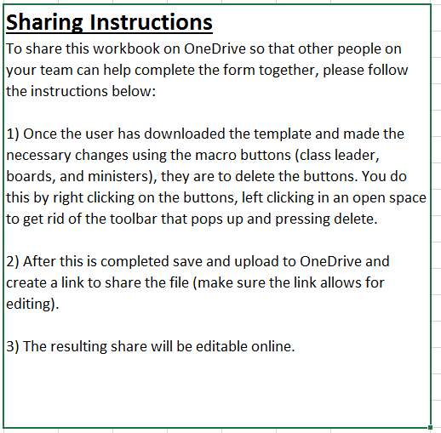
Step Two: www.AMEZionGSA.com
Integration

Slide 25
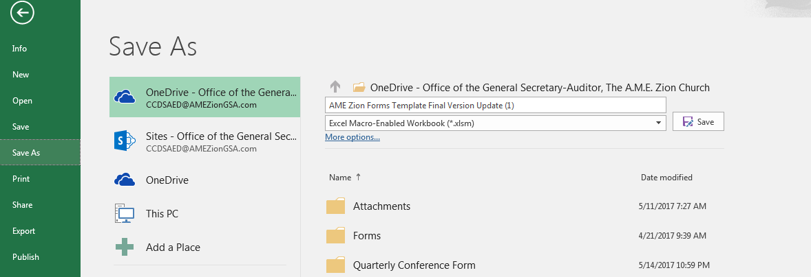
Step Two: www.AMEZionGSA.com
Integration
After this is complete, save the template to OneDrive.

Slide 26
Step Two: www.AMEZionGSA.com
Integration
Go to portal.office.com and log in.
Click on OneDrive

Slide 27
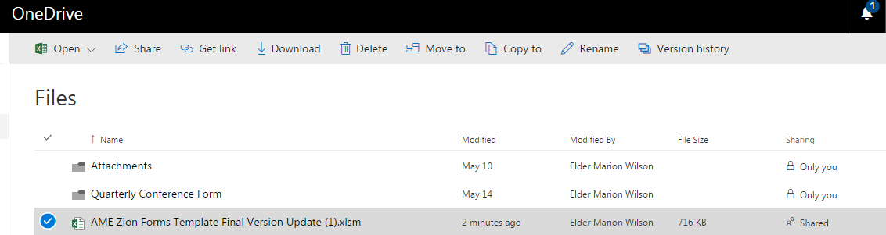
Step Two: www.AMEZionGSA.com
Integration
Then create a link in OneDrive to share the file (make sure the link allows for editing) and send email to officers and ministers who will be entering their information. The resulting share will be editable online.

Slide 28
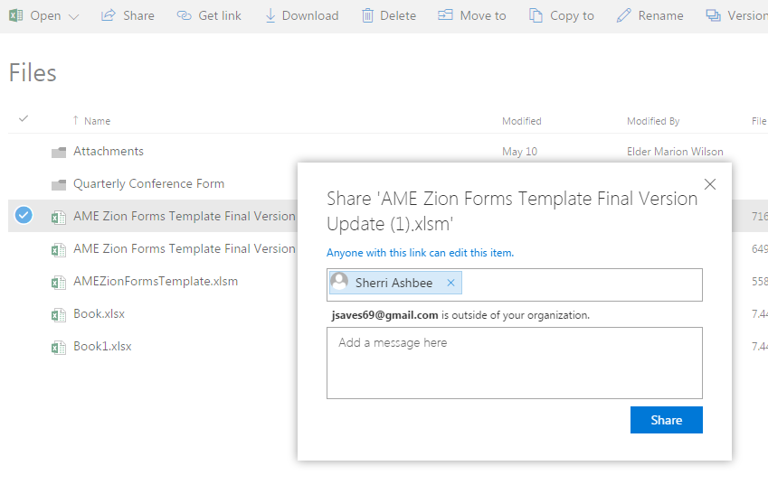
Step Two: www.AMEZionGSA.com
Integration
    This will take you to the window that allows you to invite your officers to begin to fill out their reports;

Slide 29
Step Two
Type in the complete email address of each officer and place a semi colon (;) behind each. Once you have finished entering all of the emails, press, you may add a message or press “share”.
An email will be sent to them giving them access to work in their workbook;
You may also share a “view only” with your Presiding Elder. You would send it the same way as the other “share” function. When the share button is clicked, you would click on the link that says: “anyone with this link can edit this item”, unclick the edit button, click “ok” and then click on “share”. The Elder is then able to review the document for consistency and errors, prior to uploading for final submission.
Each time you want to go to the workbook, either to complete, or to begin a new quarter, you go back to OneDrive and repeat the process mentioned;
You will only go to back to the website when you are ready to upload the report.
You’re all set to begin filling in the workbook.

Slide 30
Step Three:
Forms Completion and Upload
You are now ready to begin filling out your workbook.
    The first thing that you must do as Pastor or designee is to enter the church specific information;
    Go to the Statistical Report and enter the pertinent information at the top of the page;
    Once you do this, all of the information on each tab will be populated. You only need to do this once, at the beginning of the year;
    Your officers are now ready to fill out their reports;
    Make sure that they are working in the tab for their report ONLY;
    Once they complete their reports, they close the report. The information will auto save into the workbook;
    The Pastor should wait until all reports have been completed before the Pastor’s report is completed, as information from several reports will auto fill into the Pastor’s report;
    The Pastor should review all reports for accuracy, before uploading the report;

Slide 31
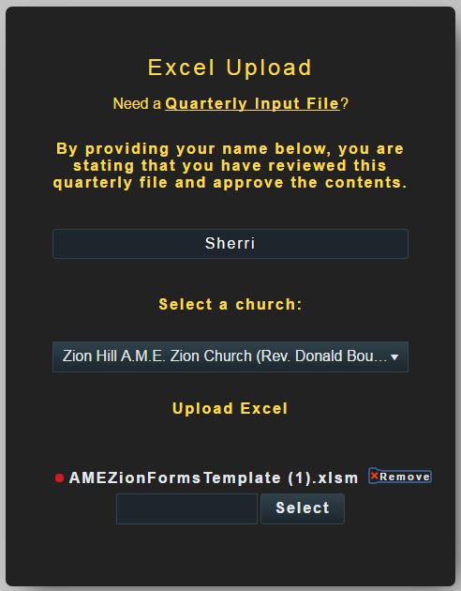
Step Three
Once the workbook is complete, the next step is to upload the document.
  The Pastor should save the file.
  The Pastor will then go back to the website (www.ameziongsa.com), click on the records tab,
    Enter the user id and password,
    Click on Import Excel File,
    On the Excel Upload page, the Pastor will read the statement: “By providing your name below, you are stating that you have reviewed this quarterly file and approve the contents.”
    The Pastor will then type their name where it ask for the pastor’s name,
    The Pastor will then select the name of their church and place it in the block that asks for the name of the church (the file cannot be uploaded until these two steps are completed),
    The Pastor or designee clicks on the blank box beside “Select”,

Slide 32
Step Three
    The Pastor finds the place where they saved the workbook and double clicks it,
    Once the file for the workbook is in the blank box, the Pastor clicks “select”. The file is now uploaded. YOU’RE DONE!!!
    You will receive a confirmation box stating that the form has been sent.
Once you’re finished uploading, you and the Presiding Elder will receive a copy of the workbook in PDF format that you can share with your officers for reading their report.
That’s it!!! Now, begin using the system. It is our hope that it will help to expedite how you manage our reporting and that it will be a blessing to the Church.
If you have any concerns or questions, please logon to www.ameziongsa.com, go to the “Contacts” section, click on “Help Desk” and enter your question. We will respond within 24-48 hours.

Slide 33
Contact Information
“Providing Doctrine, Discipline, Information and Research to “The Freedom Church” and the Kingdom of God”
Department of Records, Research & Archives,
The A.M.E. Zion Corporate Headquarters
3225 West Sugar Creek Road, Charlotte, North Carolina 28269
Voice: (704) 599-4630, ext. 2574, Email: JESadler@amezhqtr.org, or TKyles@amezhqtr.org.

