Slide 1
Leading Powerful Altar Calls
The Altar Ministry
Rev. Dr. Otis T. McMillan, Facilitator
The Department of Church Growth and Development
The African Methodist Episcopal Zion Church

Slide 2
The Reason for Extending a Public Invitation
Scriptural Reasons
Historical Reasons
Practical Reasons
Logical Reasons
Consequential Reasons

Slide 3
Scriptural Reasons
Ge 3:9 ¶ And the LORD God called unto Adam, and said unto him, Where art thou?
Ex 32:26 Then Moses stood in the gate of the camp, and said, Who is on the LORD'S side? let him come unto me. And all the sons of Levi gathered themselves together unto him.
(KJV)
1Ki 18:21 ¶ And Elijah came unto all the people, and said, How long halt ye between two opinions? if the LORD be God, follow him: but if Baal, then follow him. And the people answered him not a word. {opinions: or, thoughts}
(KJV)

Slide 4
Scriptural Reasons
Ac 2:37 ¶ Now when they heard this, they were pricked in their heart, and said unto Peter and to the rest of the apostles, Men and brethren, what shall we do?
38 Then Peter said unto them, Repent, and be baptized every one of you in the name of Jesus Christ for the remission of sins, and ye shall receive the gift of the Holy Ghost.
39 For the promise is unto you, and to your children, and to all that are afar off, even as many as the Lord our God shall call.
40 And with many other words did he testify and exhort, saying, Save yourselves from this untoward generation.
41 Then they that gladly received his word were baptized: and the same day there were added unto them about three thousand souls.

Slide 5
The Message Requires a Response
Today’s culture may minimize the need for a public commitment, yet we see in scripture, God, the Prophets, Jesus and His Disciples called His followers to confess with their mouths, to make a public declaration of faith.

Slide 6
And Jesus said unto them, Come ye after me, and I will make you to become fishers of men. Mark 1:17 (KJV)

Slide 7
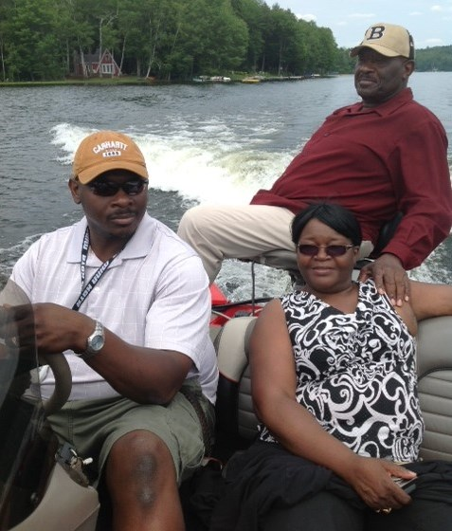
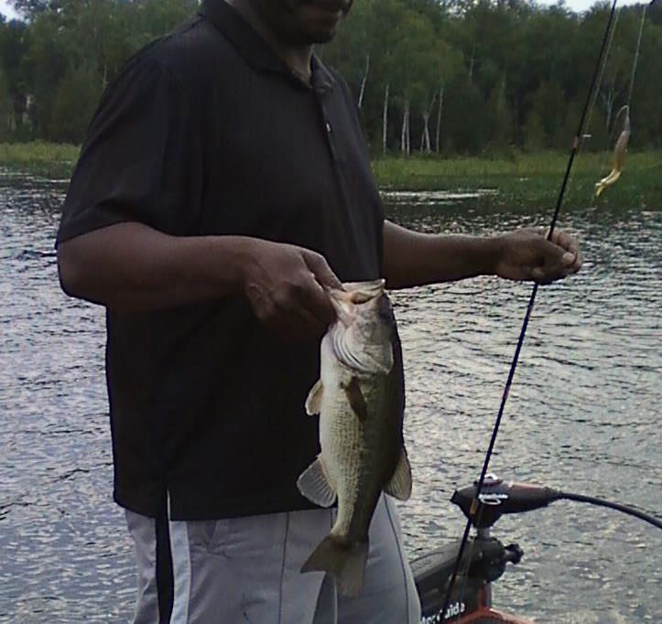
Never Go fishing Without Expectation

Slide 8
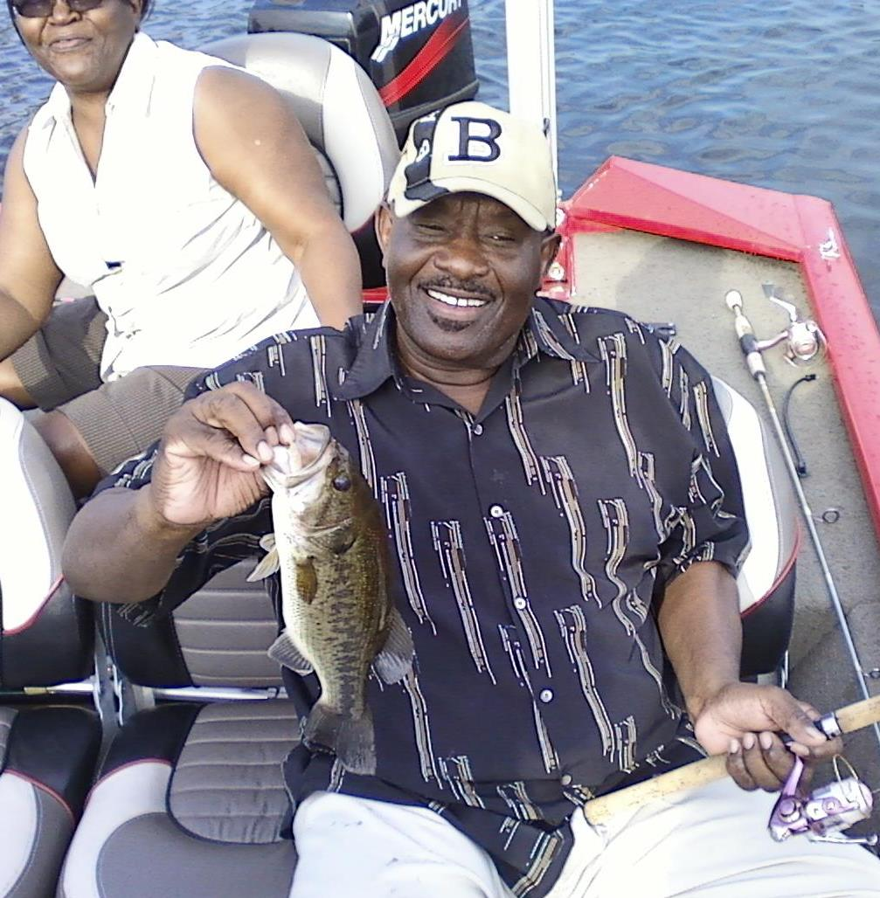
Leading The Altar Call Is A
Crucial Part of Successful Fishing

Slide 9
The Invitation Is Important!
That public declaration does three things:
1. It helps to affirm to the new believer that they have actually made a real decision, rather than thinking it’s something they “felt emotionally”.
2. It allows other believers to immediately pray with and counsel that individual.
3. It provides a mechanism to identify individuals who will need continued follow-up to become firmly grounded in their new faith.

Slide 10

Prepare For The Invitation
Preaching is always for a response. All may not have great preaching ability, but all can learn how to give a strong invitation.
How will you give the invitation? Will you use a song? How long will you wait? How will you present the invitation?
(I believe the preacher should give his/her own invitation because he/she knows the goal.)

Slide 11
If You Prayerfully Prepare the Message, You Should Prayerfully Prepare for the Invitation! Be clear about what people are asked to do.

Slide 12
Is this a call to Salvation?
Is this a call to Rededication?
Is this a call for the Assurance of Salvation?
Is this a call to special Prayer?
What response am I looking For?

Slide 13
Prepare For The Invitation
Prayer: The Secret to a Burning Heart.
Pray for God to break your heart for the lost.
Pray for God to save the lost who are present.
Pray for God to enable you to prepare and make an effective altar call.

Slide 14
Prepare For The Invitation
Make the Transition: connect the message to the invitation by asking an appropriate question and supplying a scriptural promise.
Give Theological Instructions: repent, believe and surrender.
The proper use of Persuasion (urgency)
Select a Motivational Theme: seek to touch the will and emotions.

Slide 15

Call to a Public Commitment
Keep it simple.
Keep it personal.
Keep it Positive.
Keep it brief.
Keep it direct.

Slide 16
Invitational Models
The Delayed-Response. How will it happen? Where will it happen? Who will be available to assist?
The Immediate-Response. I going to ask you to…close your eyes, Come forward, raise your hand, stand at your seat, be clear and honest!

Slide 17
Suggestions for Gaining a Response
Asking inquirers to come forward. This is used at evangelistic Crusades, worship services and celebrations. It is an excellent way for an individual to make a public confession of their desire to trust in Christ
Asking inquirers to raise their hands. This may be the best option if your space is limited for people to come forward. You’ll want to ask the inquirers to meet with your prayer team in a designated place immediately following the service and have your prayer team there.

Slide 18

Suggestions for Gaining a Response
Completing a response card. If, for some reason, the above options aren’t feasible for your situation, you may want to use this option. You’ll need to decide how you’ll distribute and collect the response card, as well as how you will follow-up with those who respond.

Slide 19
What If No One Responds?
This is a common question and fear that many have about giving a salvation invitation. But the truth is, we have nothing to fear. A salvation invitation is not something personally coming from us.
“God holds us responsible for faithful evangelism, not for successful evangelism.” Ralph Bell

Slide 20

The Importance of Counseling
(Gender specific whenever possible)
The Need for Personal Workers
The Need for Inquiry Room
The Need for Training and Procedures

